Slide 1
RandomJobs
Team members:
Asfi Rahman, 180042116
Afnan Jarif , 180042139
Md. Reynaus Salehin, 180042148

Slide 2




Project Overview
It is a platform where people can be hired for a certain task. It helps a person to find jobs inside his area or near him which he might prefer to do.
Here we offer not only formal jobs but also informal jobs. Such as, any kind of help in household works and others.

Slide 3
Use Case
Two types of user:
Job seeker
Recruiter

Slide 4
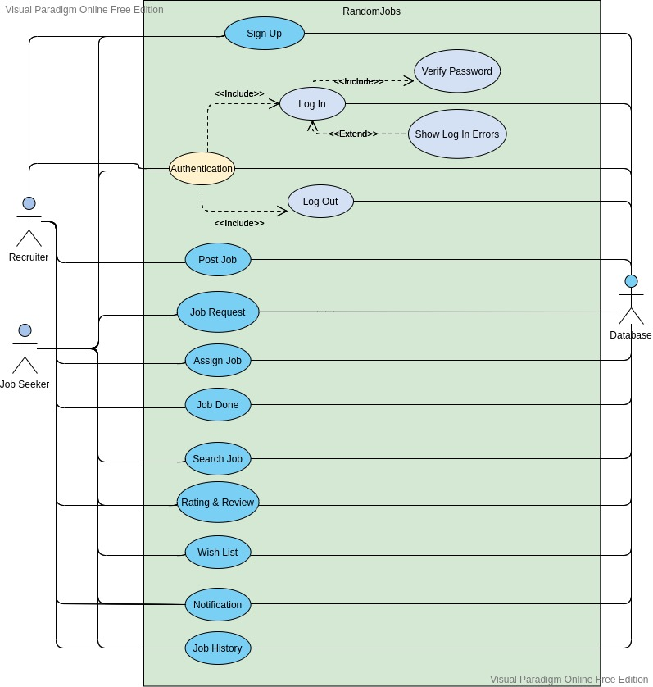

Slide 5
Dropped Features
Preferable jobs’ list for job seekers.
Rating system.

Slide 6
Demo

